Slide 1
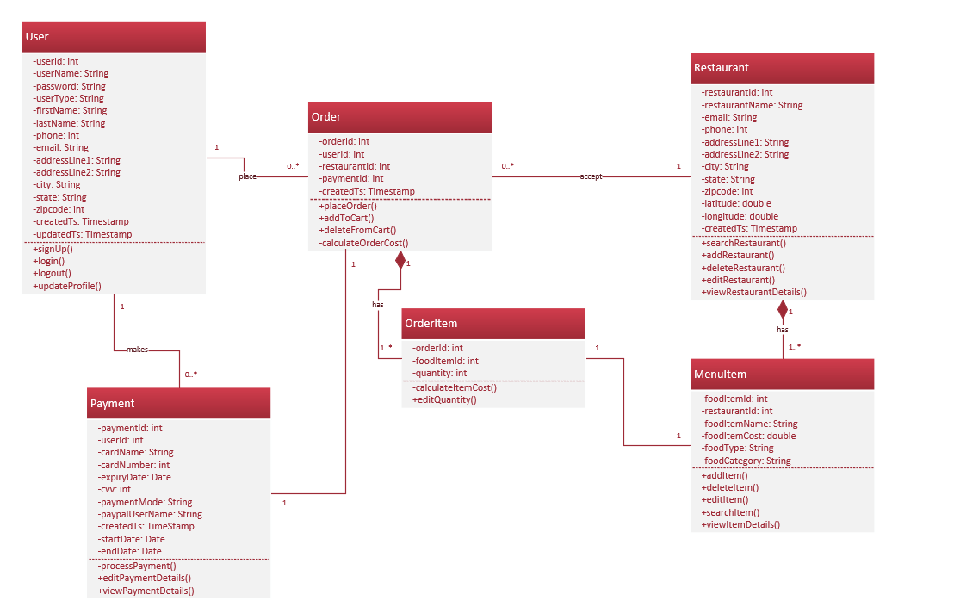
NutraMeals
Class Diagram

